Slide 1

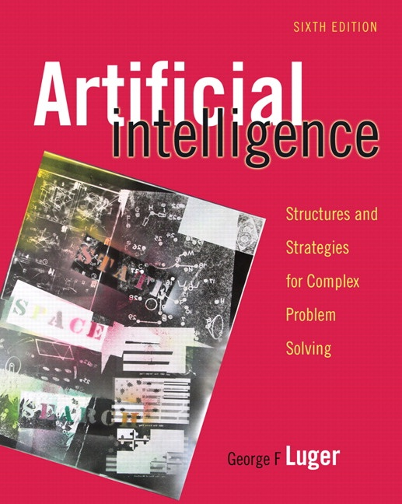
Artificial Intelligence:
Its Roots and Scope
1.1 From Eden to ENIAC: Attitudes
toward Intelligence,
Knowledge, and Human Artifice
1.2 Overview of AI Application Areas
1.3 Artificial Intelligence – A Summary
1.4 Epilogue and References
1.5 Exercises
George F Luger
ARTIFICIAL INTELLIGENCE 6th edition
Structures and Strategies for Complex Problem Solving
Luger: Artificial Intelligence, 6th edition. © Pearson Education Limited, 2009
Notes:
OWEN: Insert chapter number
www.cs.fsu.edu/~lacher/courses/CAP5605/lectures/SixthEdChap1.ppt

Slide 2
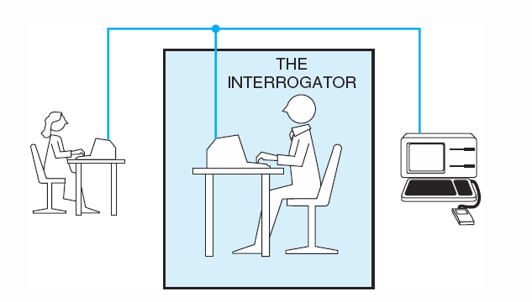
Fig 1.1 The Turing test.
Luger: Artificial Intelligence, 6th edition. © Pearson Education Limited, 2009

Slide 3
Important Research and Application Areas
1.2.1 Game Playing
1.2.2 Automated Reasoning and Theorem Proving
1.2.3 Expert Systems
1.2.4 Natural Language Understanding and Semantic Modeling
1.2.5 Modeling Human Performance
1.2.6 Planning and Robotics
1.2.7 Languages and Environments for AI
1.2.8 Machine Learning
1.2.9 Alternative Representations: Neural Nets and Genetic Algorithms
1.2.10 AI and Philosophy
Luger: Artificial Intelligence, 6th edition. © Pearson Education Limited, 2009

Slide 4
Important Features of Artificial Intelligence
The use of computers to do reasoning, pattern recognition, learning, or some other form of inference.
A focus on problems that do not respond to algorithmic solutions. This underlies the reliance on heuristic search as an AI problem-solving technique.
A concern with problem-solving using inexact, missing, or poorly defined information and the use of representational formalisms that enable the programmer to compensate for these problems.
Reasoning about the significant qualitative features of a situation.
An attempt to deal with issues of semantic meaning as well as syntactic form.
Answers that are neither exact nor optimal, but are in some sense “sufficient”. This is a result of the essential reliance on heuristic problem-solving methods in situations where optimal or exact results are either too expensive or not possible.
The use of large amounts of domain-specific knowledge in solving problems. This is the basis of expert systems.
The use of meta-level knowledge to effect more sophisticated control of problem-solving strategies. Although this is a very difficult problem, addressed in relatively few current systems, it is emerging as an essential are of research.
Luger: Artificial Intelligence, 6th edition. © Pearson Education Limited, 2009

